Slide 1
EXPRESSION TREE EVALUATION IMPLEMENTING INFIX, PREFIX, AND POSTFIX TRAVERSAL

Slide 2
OBJECTIVES:
The objective of this project is to design and implement an expression tree evaluation system capable of handling infix, prefix, and postfix expressions efficiently. This project aims to explore fundamental data structures and algorithms related to expression parsing and evaluation, with a focus on the utilization of expression trees as a versatile tool for expression manipulation and calculation. Key objectives include:
Implementing algorithms for converting infix, prefix, and postfix expressions to expression trees.
Developing algorithms for evaluating expression trees to compute the result of the given expressions accurately.

Slide 3
Exploring methods to handle various operators, operands, and parentheses efficiently in each expression notation.
Ensuring robust error handling and validation mechanisms to handle invalid expressions gracefully.
Evaluating the performance of the implemented system in terms of time and space complexity for different types and sizes of expressions.
Providing a user-friendly interface or API for users to input expressions in any notation and retrieve accurate results.
Documenting the design, implementation, and usage of the expression tree evaluation system comprehensively for future reference and understanding.
By achieving these objectives, the project aims to enhance understanding and proficiency in expression parsing, evaluation, and tree-based data structures, facilitating the development of versatile and efficient expression evaluation tools.

Slide 4
TREE
A tree is a type of graph data structure composed of nodes and edges. Its main properties are
It is acyclic (doesn't contain any cycles);
There exists a path from the root to any node;
Has N - 1 edges, where N is the number of nodes in the tree
Each node has exactly one parent node with the exception of the root node

Slide 5
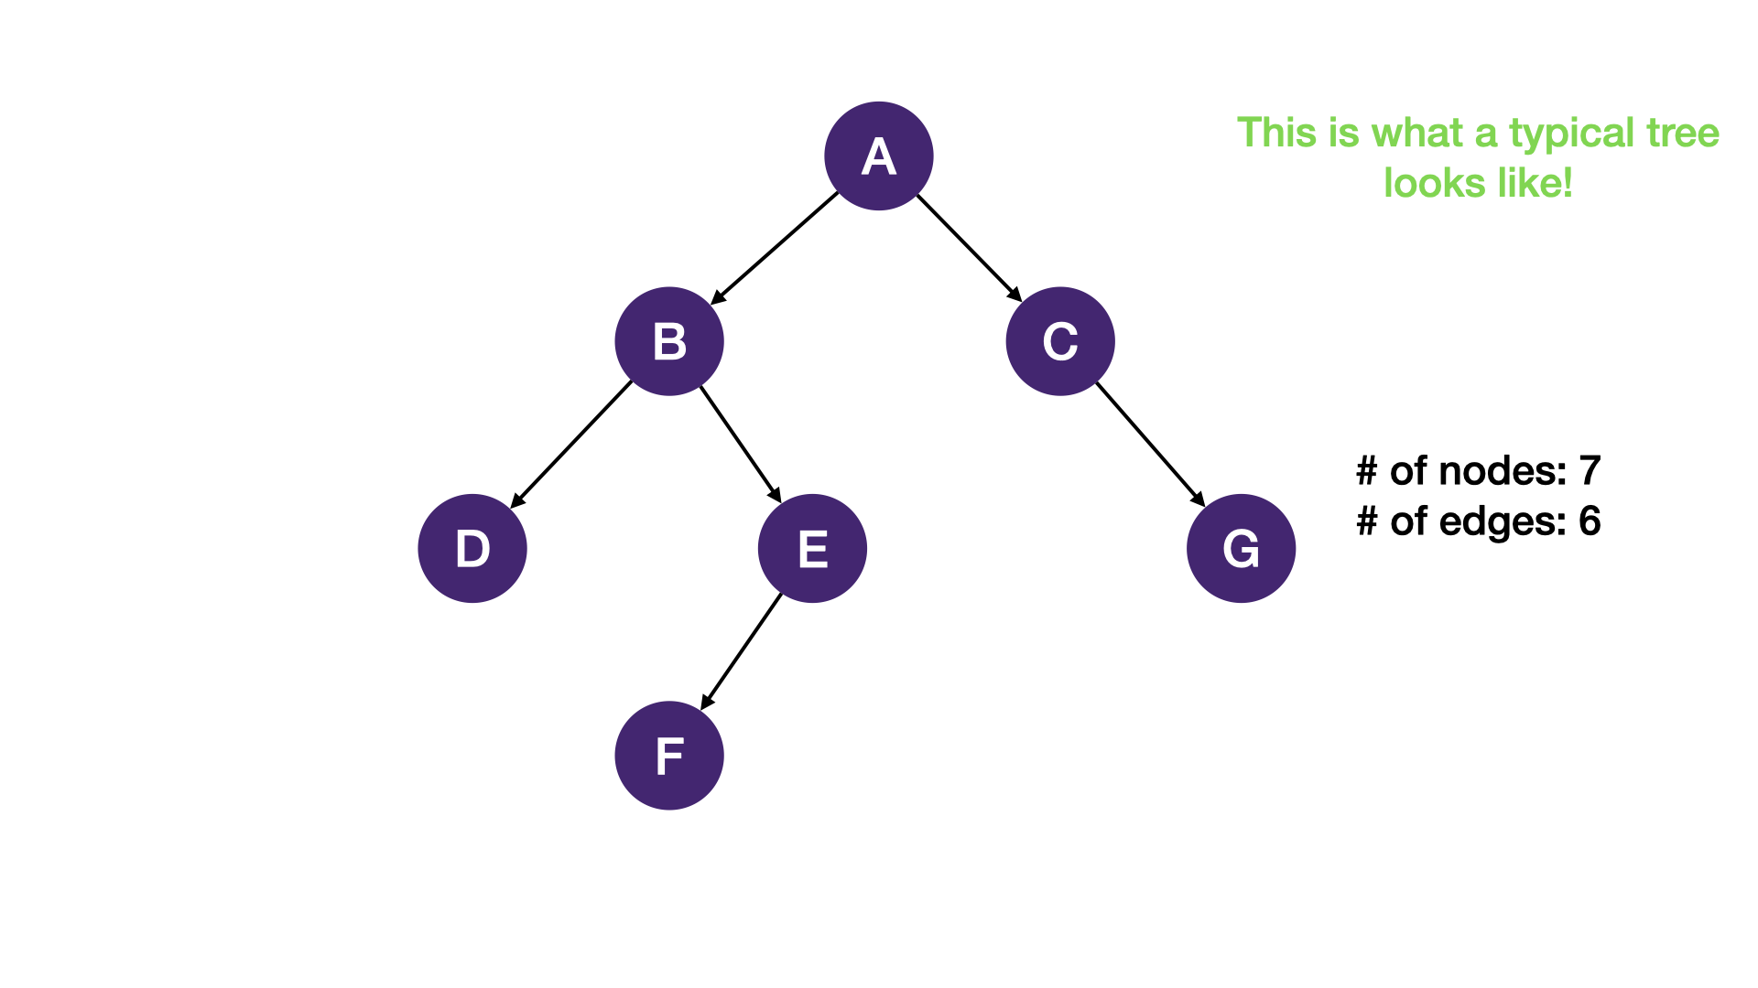

Slide 6
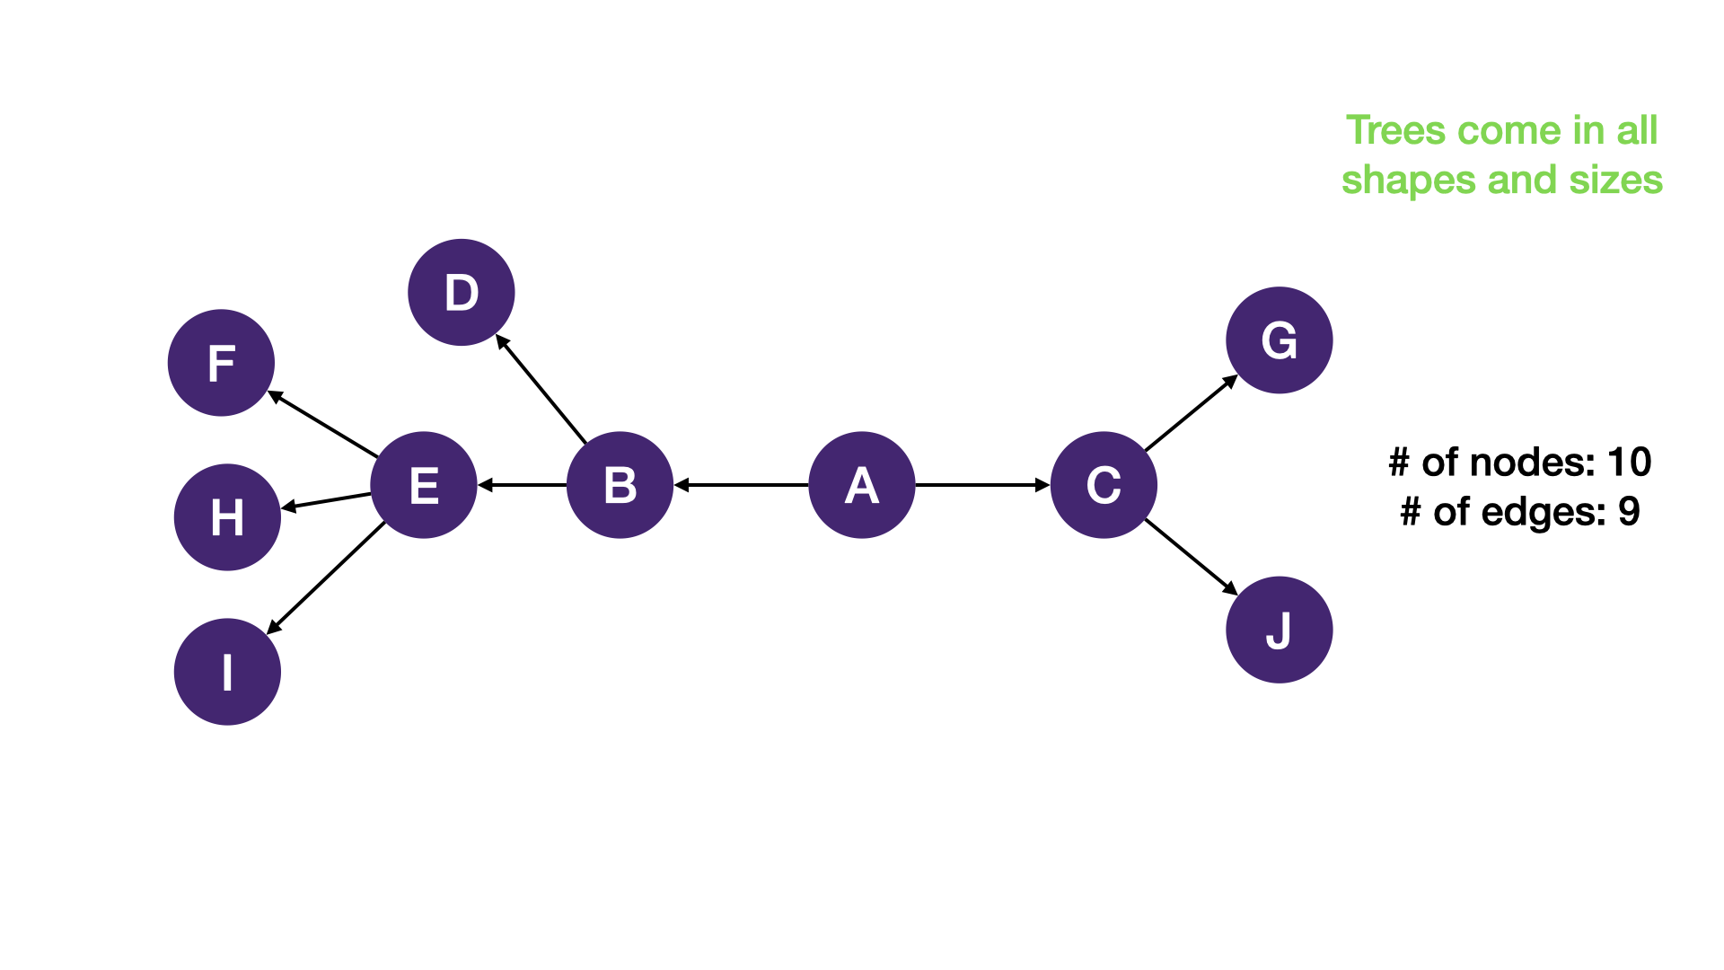

Slide 7
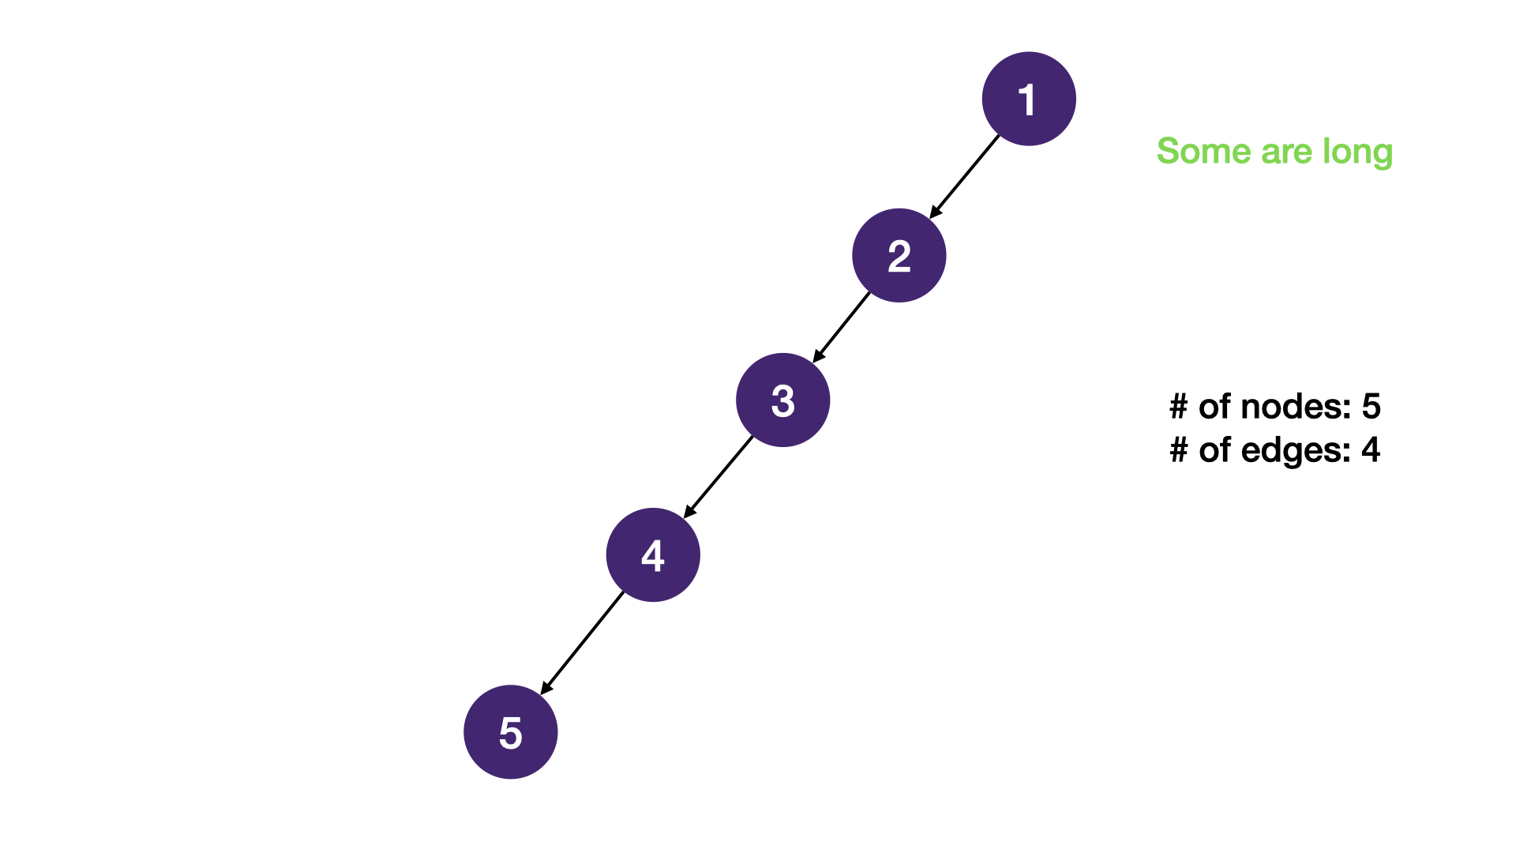

Slide 8
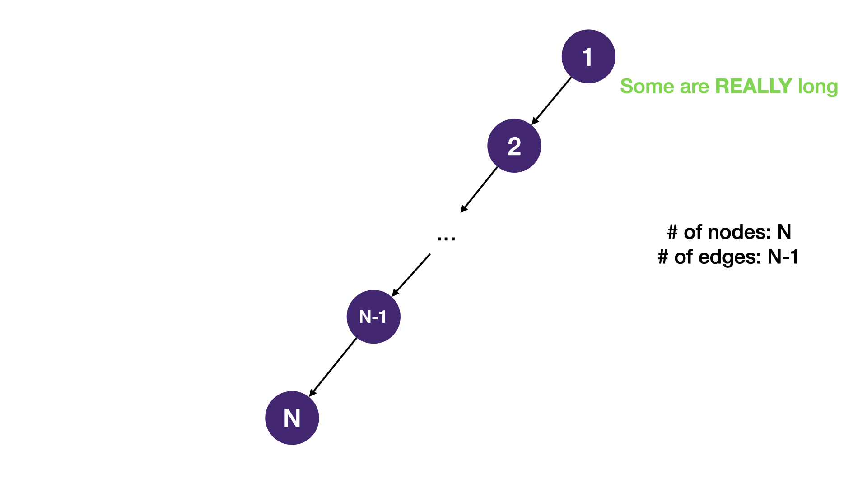

Slide 9
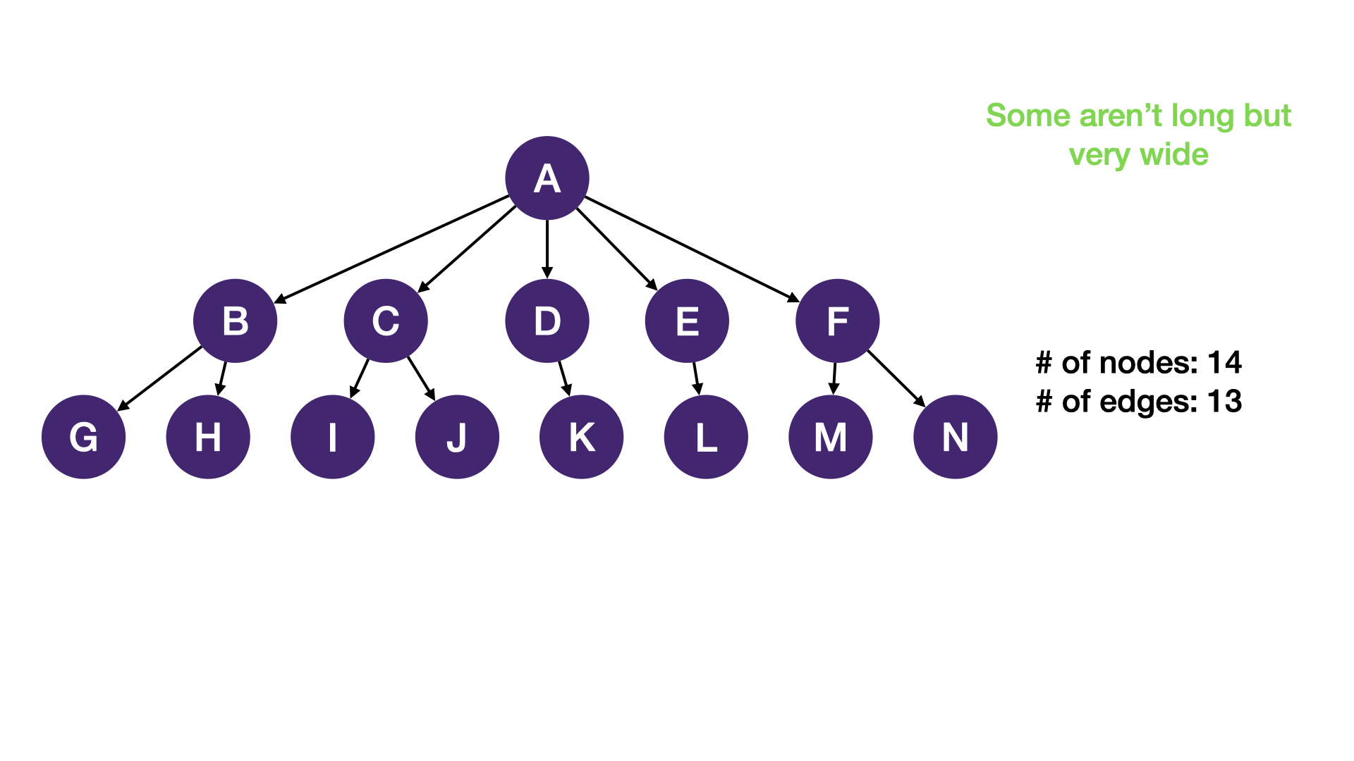

Slide 10
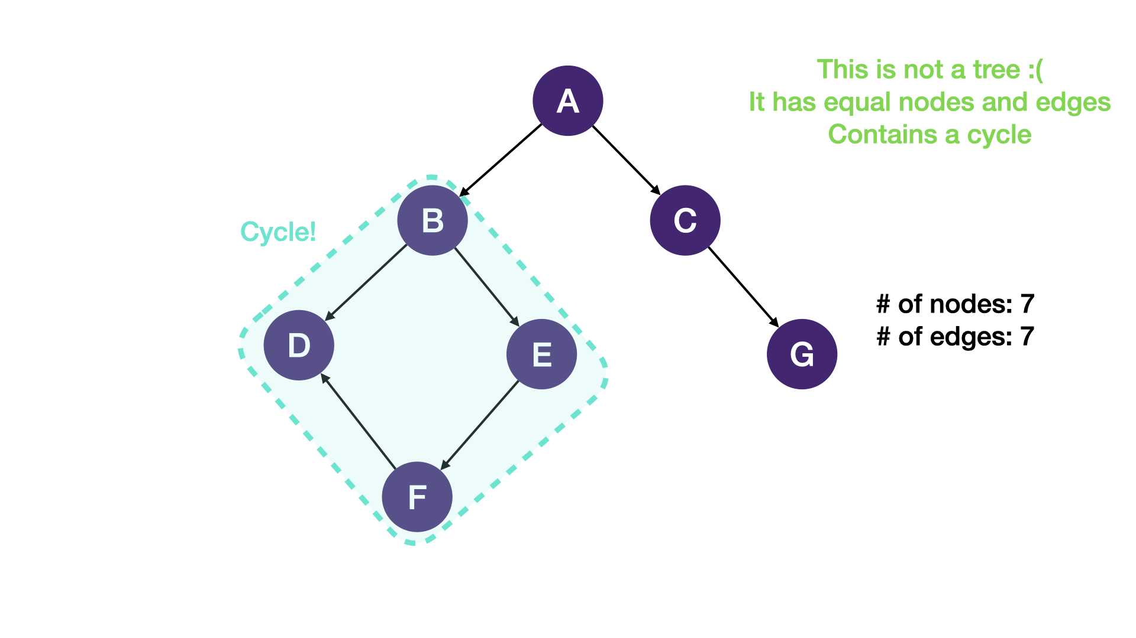

Slide 11
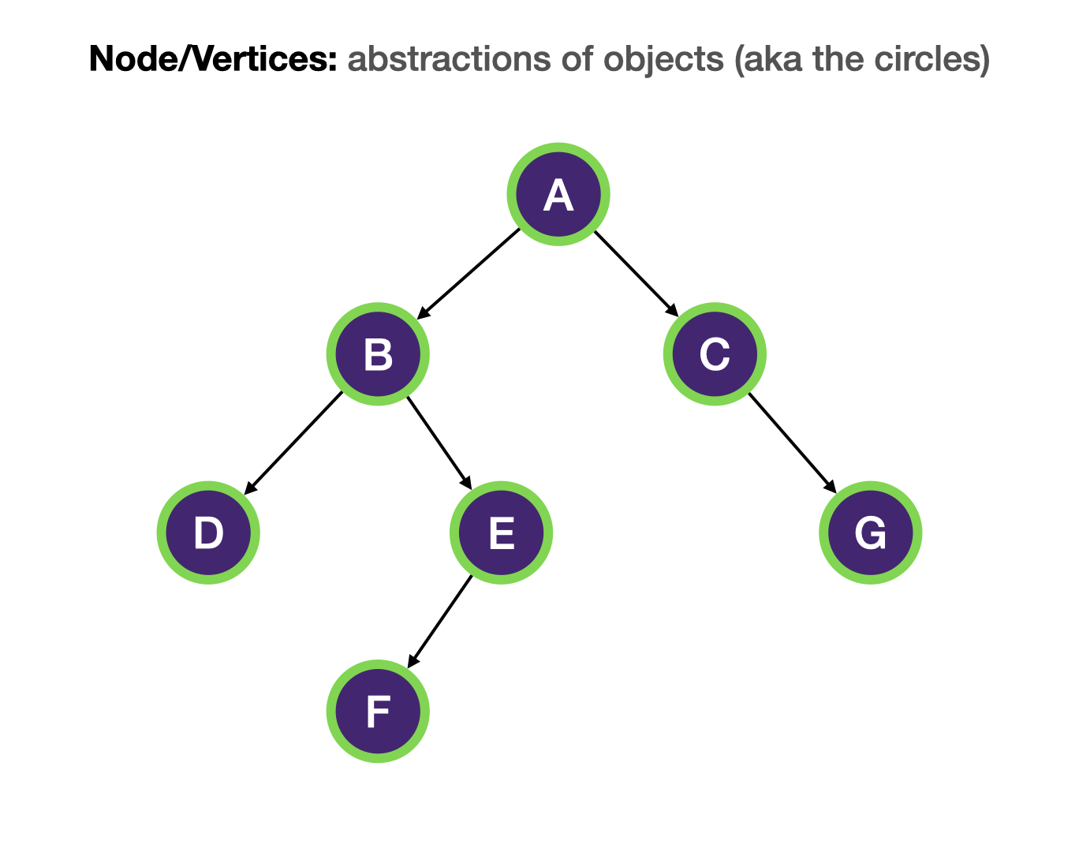
TERMINOLOGY:

Slide 12
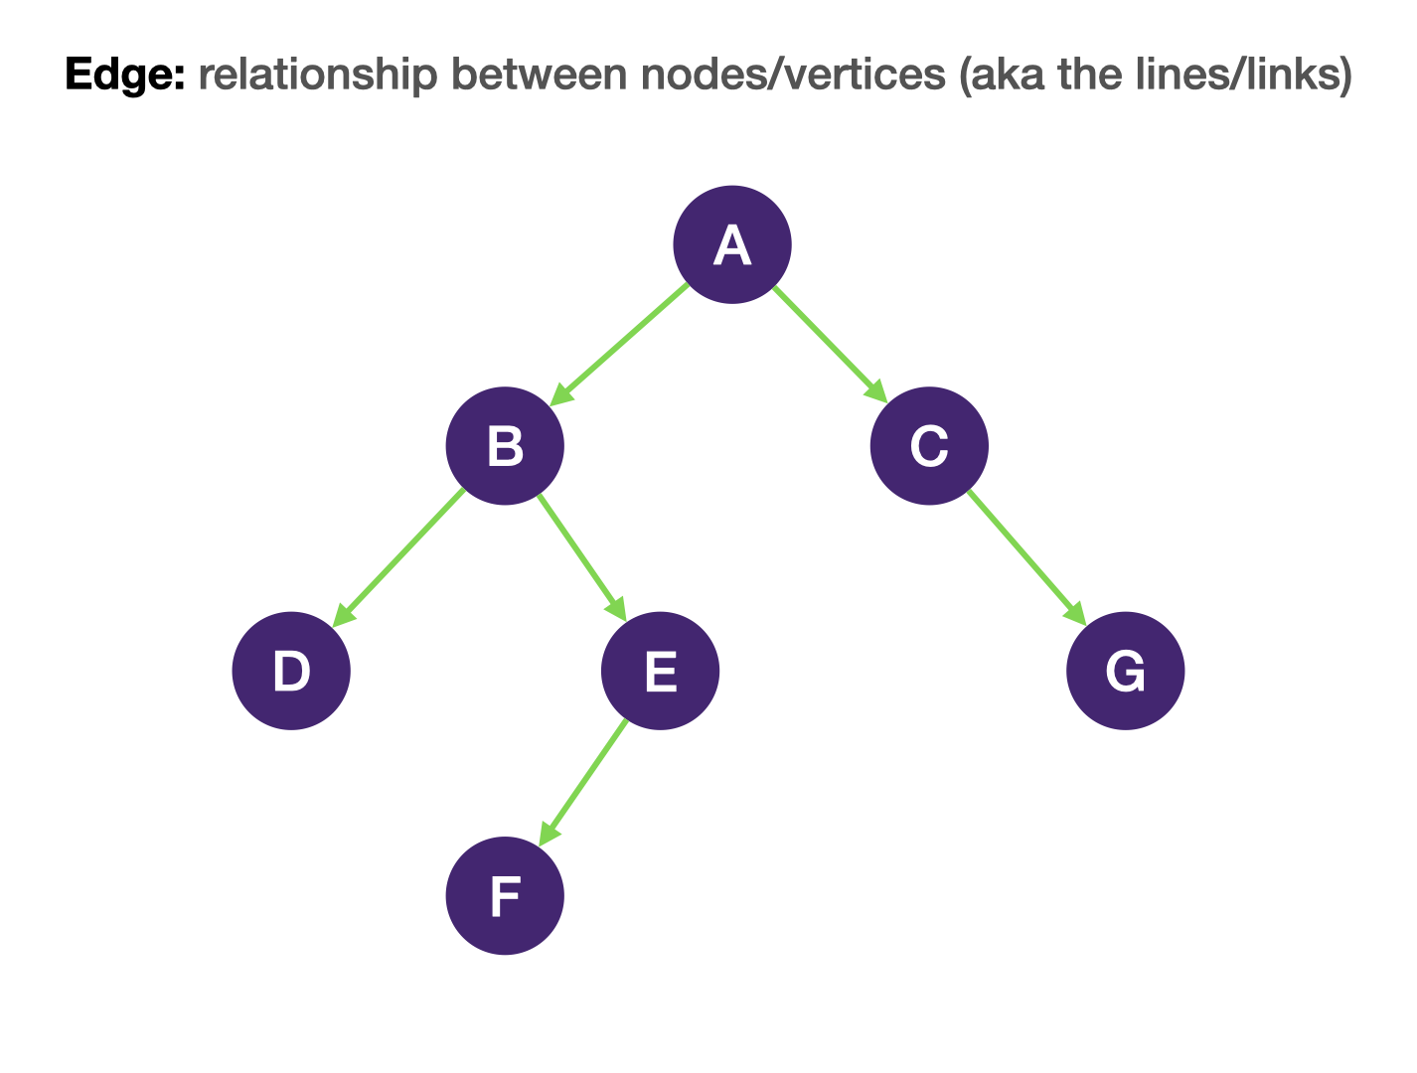
TERMINOLOGY:

Slide 13
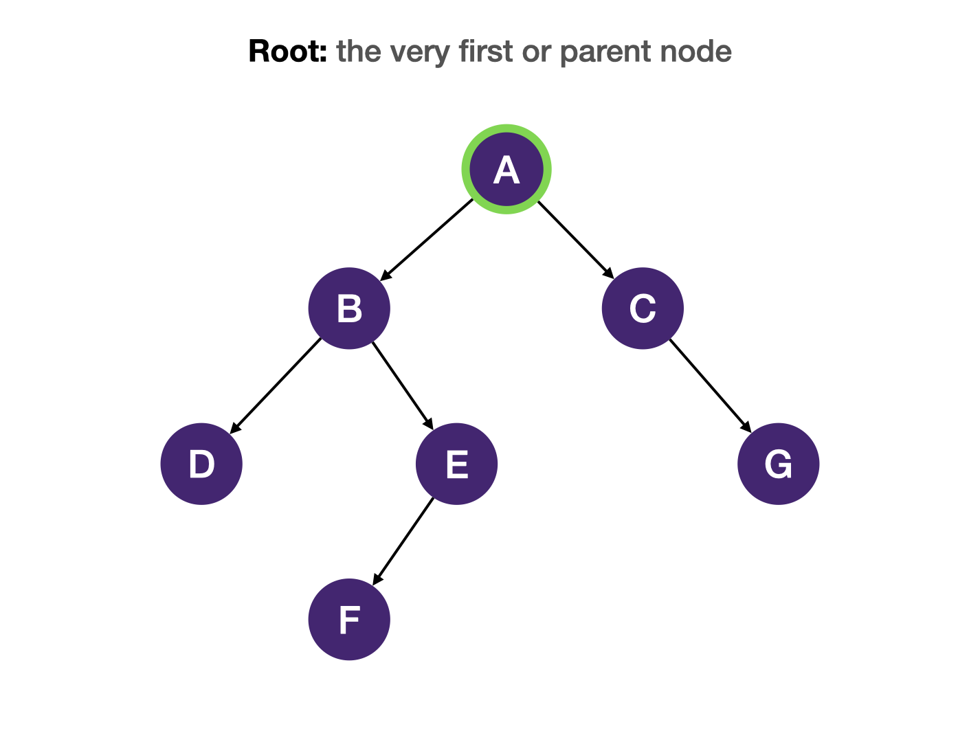
TERMINOLOGY:

Slide 14
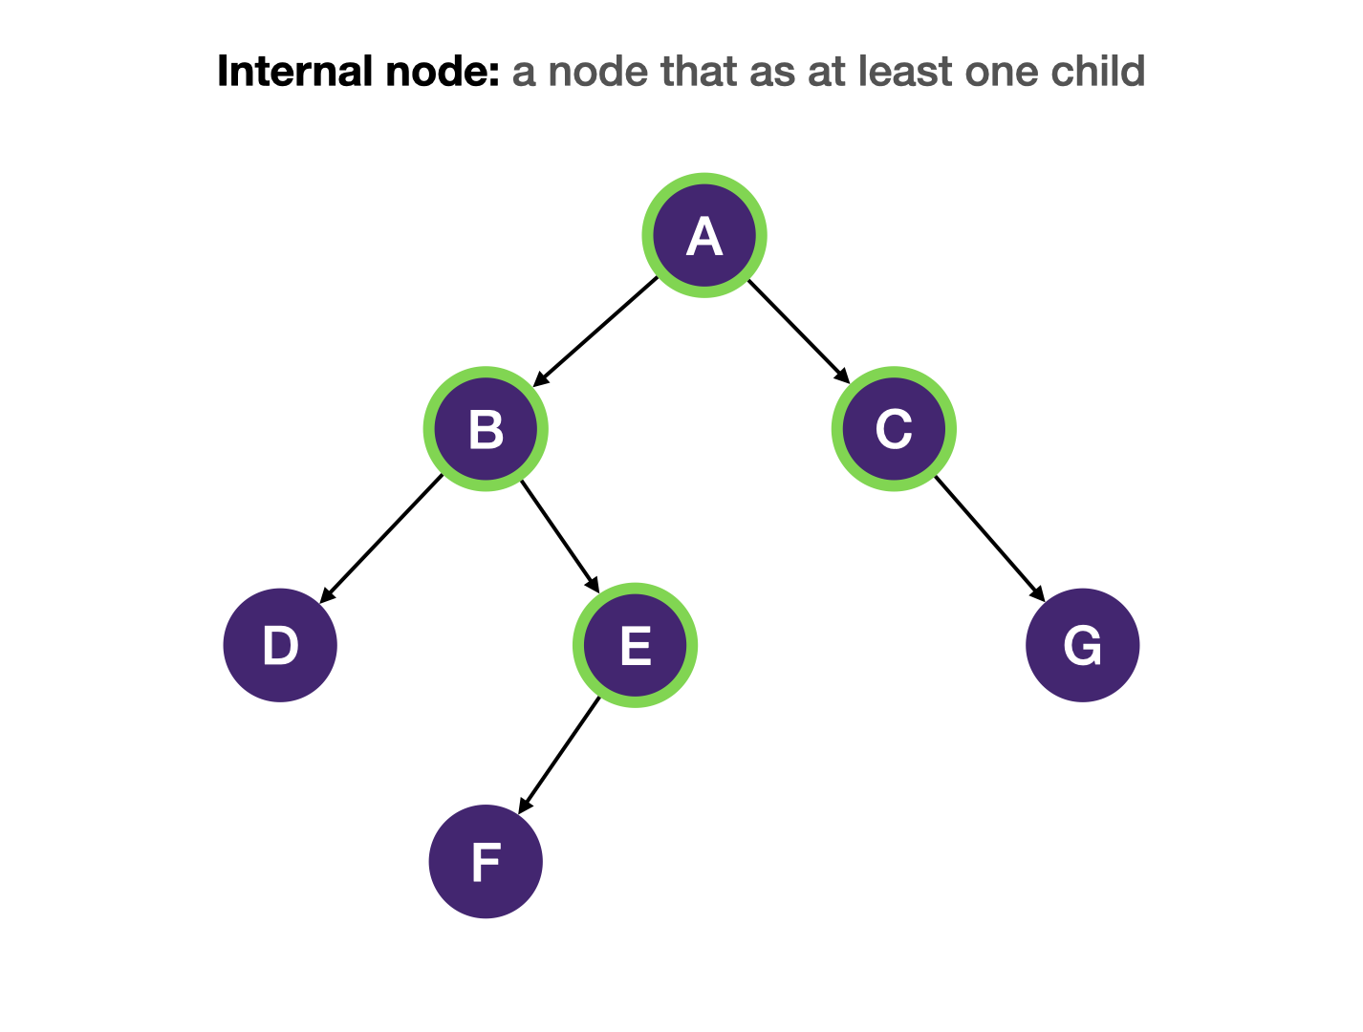
TERMINOLOGY:
Internal node:
every node in a tree that has at least one child node.

Slide 15
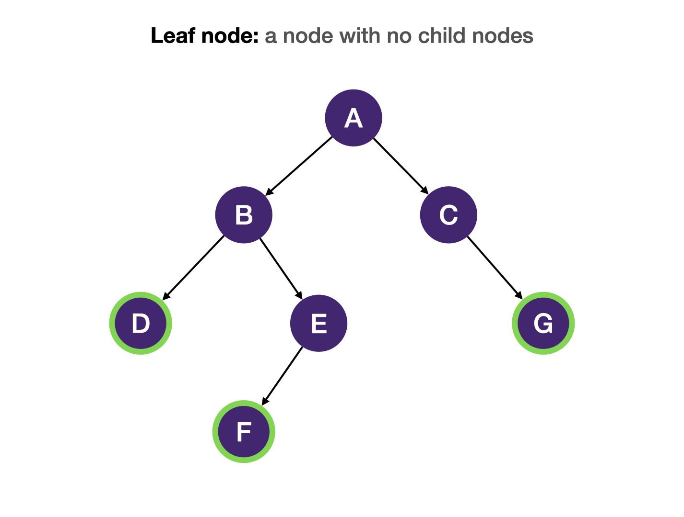
TERMINOLOGY:
Leaf node:
every node in a tree that has no child nodes.

Slide 16
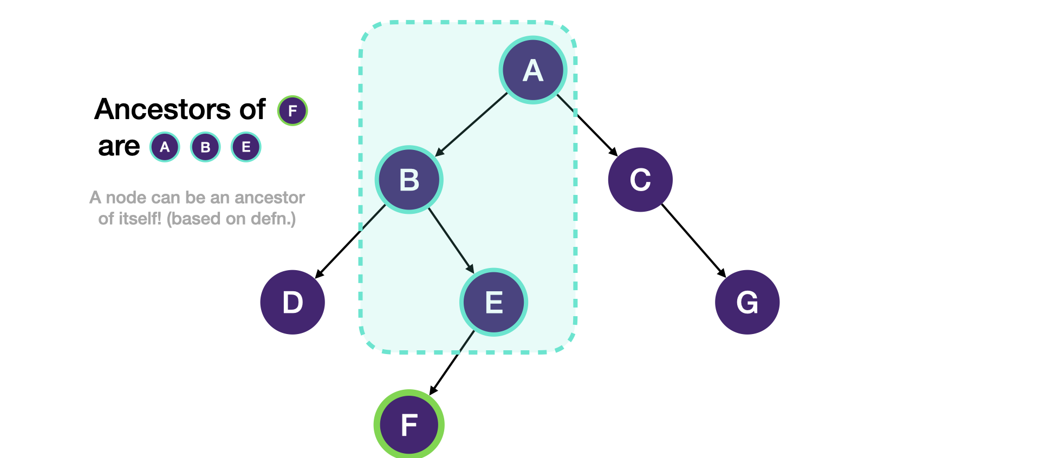
TERMINOLOGY:
Ancestor:
all the nodes that are between the path from the root to the current node are the ancestors of the current node. An ancestor node of the current node is either the parent of the current node or the parent of another ancestor of the node..

Slide 17
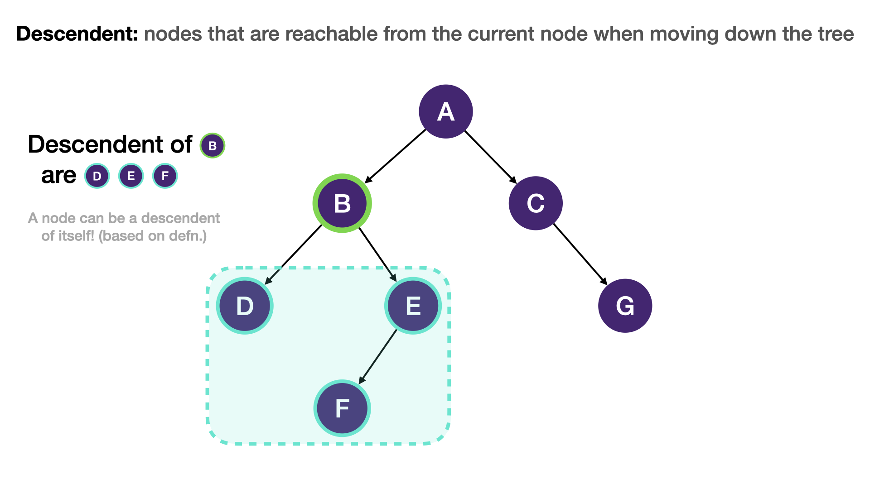
TERMINOLOGY:
Descendent:
all the nodes that are reachable from the current node when moving down the tree are the descendants of the current node. A descendant of the current node is either a child of the node or a child of another descendant of the node.

Slide 18
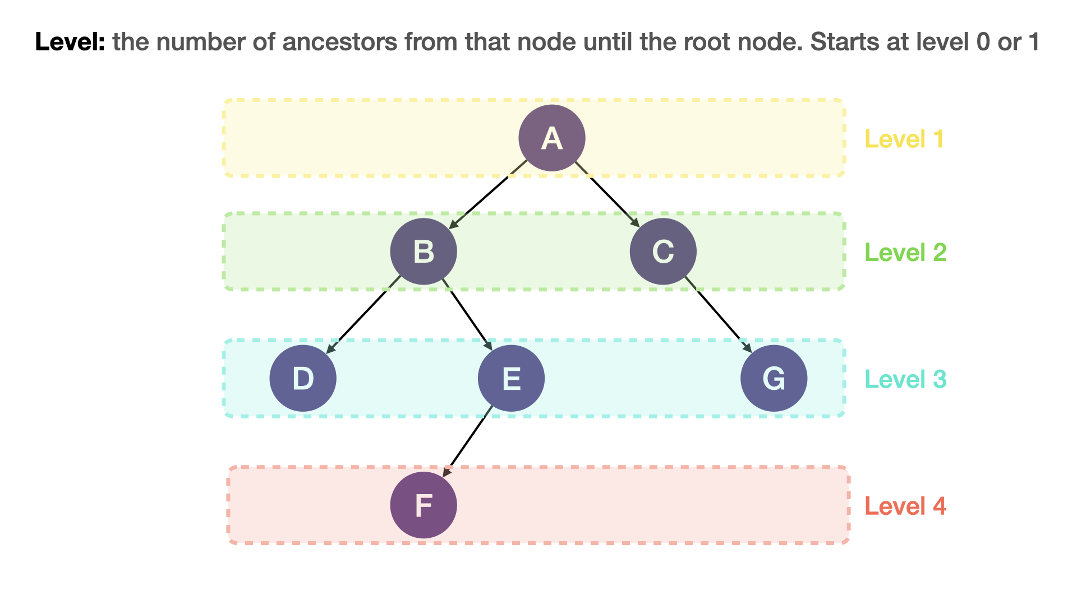
TERMINOLOGY:
Level:
the number of ancestors from the node to the root nodes.

Slide 19
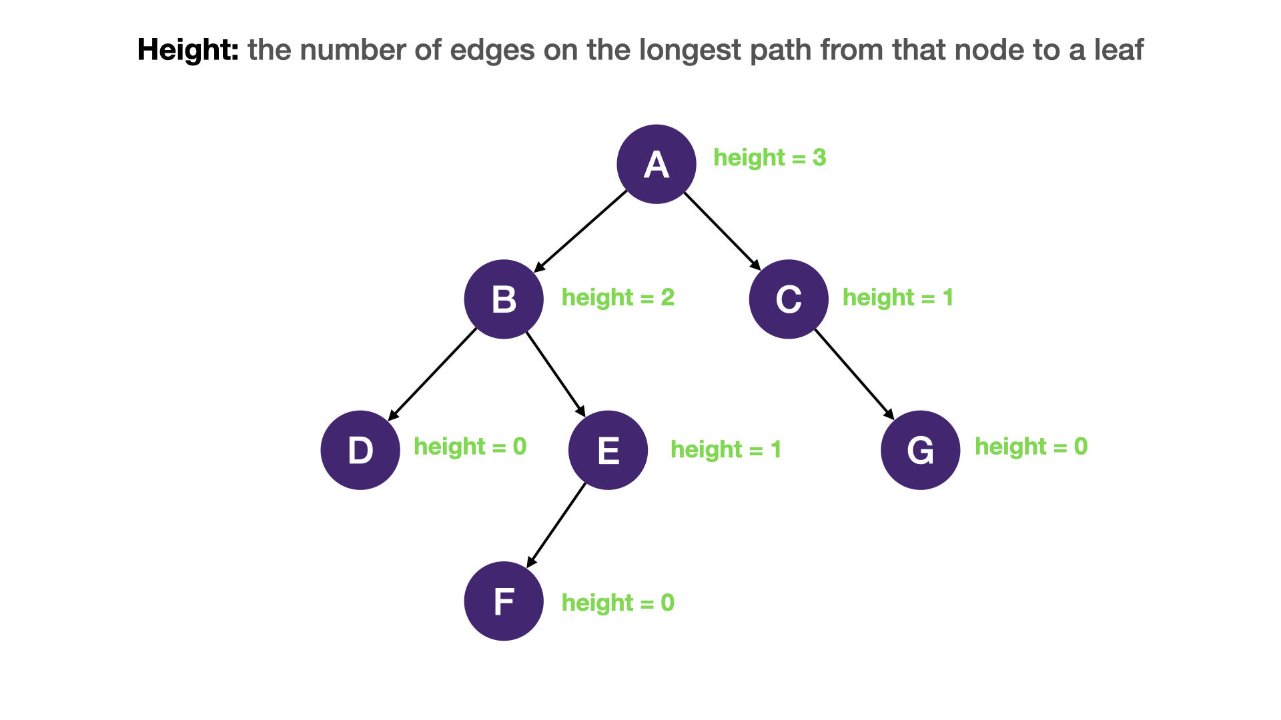
TERMINOLOGY:

Slide 20
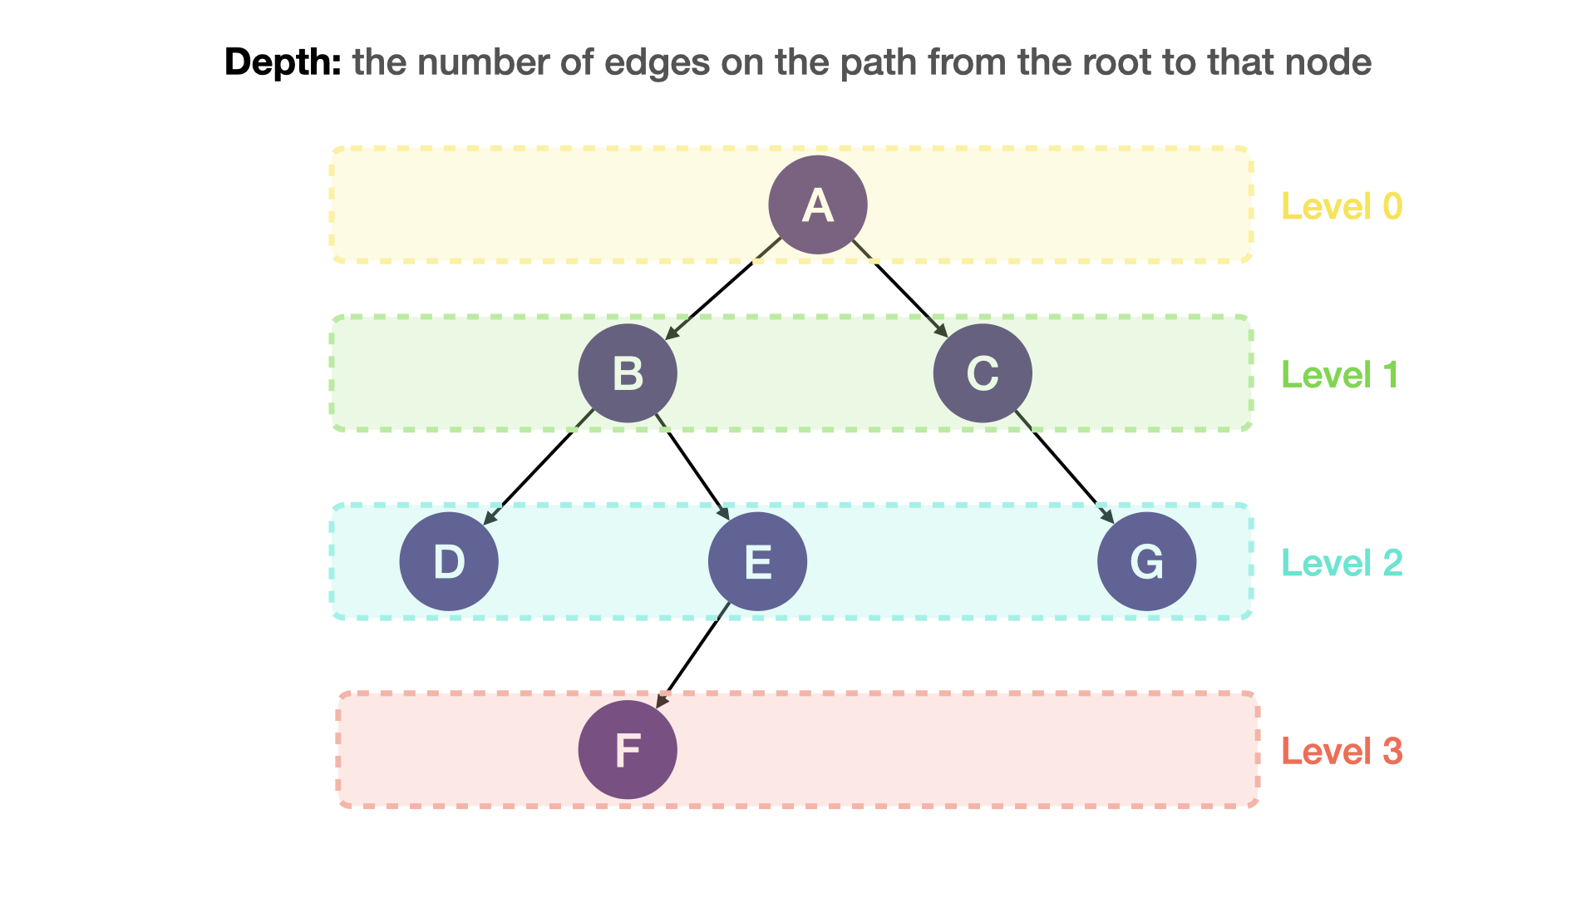
TERMINOLOGY:

Slide 21
BINARY TREE

Slide 22
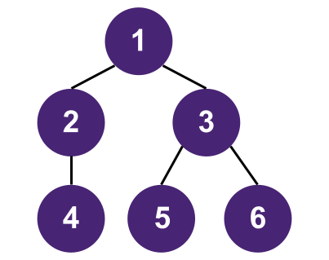
Binary Tree
An binary tree is a tree in which each node has no more than n children. A binary tree is a type of binary tree with n = 2, so every node in a binary tree has 0 to 2 children.

Slide 23
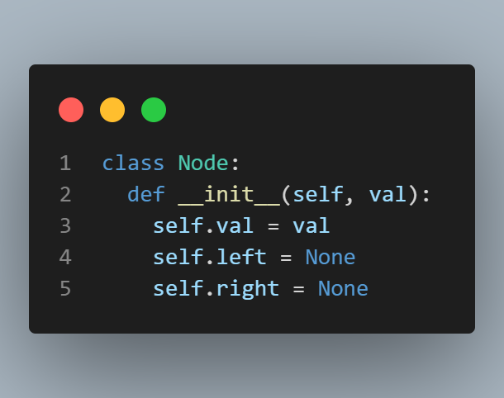
Binary Tree implementation

Slide 24
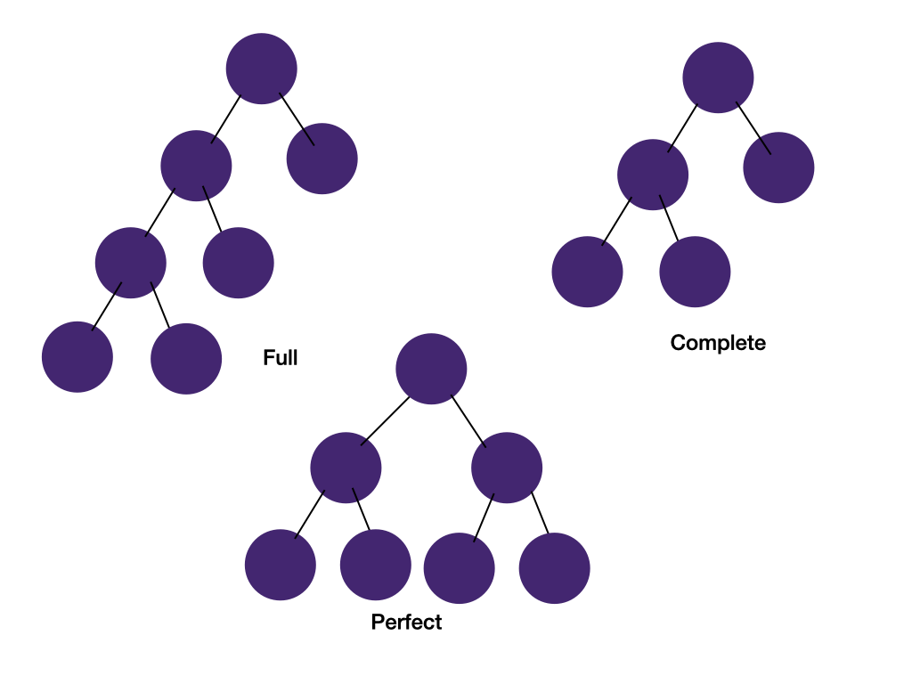
Full, Complete and Perfect Binary Trees (Balanced and unbalanced)

Slide 25
Full binary tree
Every node has 0 or 2 children.
Complete binary tree
All levels are completely filled except possibly the last level and all nodes in the last level are as far left as possible. This may sound like an odd concept. We will see its usage in the heap section.
Perfect binary tree
All internals nodes have two children and all leaf nodes have the same level. Perfect binary trees are often used to estimate time complexity for combinatorial problems where the search space is a perfect binary tree.

Slide 26
BINARY SEARCH TREE

Slide 27
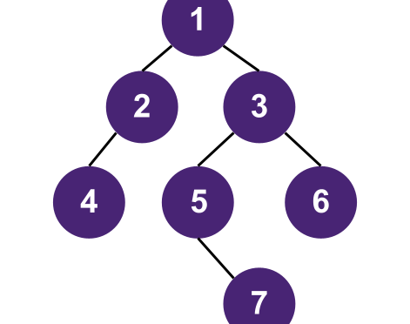
Binary search Tree
A binary search tree (BST) is a special type of binary tree, in which every nodes follows the ordering property of (all left descendent )< node < (all right descendent).
Balanced Binary Tree
Every node in a balanced binary tree fullfill the condition--the height difference of the left and right subtree of the node is not more than 1. Searching, insertion, and deletion in a balanced binary tree takes O(log n) instead of O(n) in an unbalanced binary tree. This is an example of a balanced binary tree:
Some common types of balanced binary trees are Red-black trees and AVL trees. It's good to be aware of these trees but they are too complex to be asked in a coding interview.

Slide 28
TREE TRAVERSAL

Slide 29
In-order Traversal:
In-order traversal visits the left branch first, then the current node, and finally the right branch. The diagram below shows the traversal order of an in-order traversal on a binary tree.

Slide 30
Pre-order Traversal:
Pre-order traversal visits the current node first, then the left subtree, and finally the right subtree. The diagram below shows the traversal order of a pre-order traversal on a binary tree.

Slide 31
Post-order Traversal:
Post-order traversal visits the left subtree first, then the right subtree, and finally the current node. The diagram below shows the traversal order of a post-order traversal on a binary tree.

Slide 32


Slide 33
INTRODUCTION
An expression tree in Data structure is used to represent an expression in the form of a tree.
After generating the expression tree of an expression, we can perform inorder traversal to generate infix expressions.
Similarly, doing a postorder traversal of the expression tree will generate postfix expressions.

Slide 34
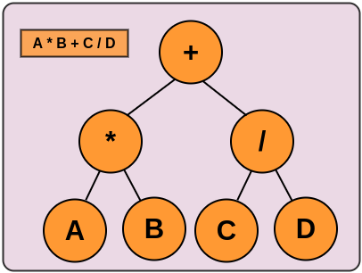
WHAT IS AN EXPRESSION TREE IN DATA STRUCTURE?
Expression trees are used to express a mathematical expression in the form of a binary tree. Expression trees are binary trees in which each internal (non-leaf) node is an operator and each leaf node is an operand.
First, let us discuss how to evaluate a given expression tree in data structure. For example, if we have an expression A * B + C / D. Then, the expression tree would be like the image given below:

Slide 35
USE OF EXPRESSION TREE IN DATA STRUCTURE
Expression trees are used to evaluate mathematical expressions by traversing the tree in a specific order (such as in-order, post-order or pre-order). This approach allows the tree to be evaluated recursively and efficiently. Additionally, an expression tree can be used to convert the expressions from infix notation to postfix or prefix notation and vice versa.
Expression trees are also used in compilers and interpreters to represent the syntax tree of a program. This allows for easy manipulation and evaluation of the program's structure and logic.
Expression trees are also used in computer algebra systems and symbolic computation software to manipulate algebraic expressions by simplification, differentiation, and integration.

Slide 36
PROPERTIES OF EXPRESSION TREE IN DATA STRUCTURE
The operands are always represented by the leaf nodes. These operands are always used in the operations.
The operator at the root of the tree is always given top priority.
When compared to the operators at the bottom of the tree, the operator at the bottom is always given the lowest priority.
Because the operand is always present at a depth of the tree, it is given the highest priority of all operators.
The expression tree can be traversed to evaluate prefix expressions, postfix expressions, and infix expressions.

Slide 37
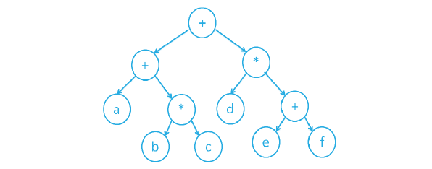
In summary, the value present at the depth of the tree has the highest priority when compared to the other operators located at the top of the tree. The expression tree is immutable, and once built, we cannot change or modify it further, so to make any changes, we must completely construct the new expression tree.
The given expression can be evaluated using the expression tree in data structure.
a + (b * c) + d * (e + f)

Slide 38
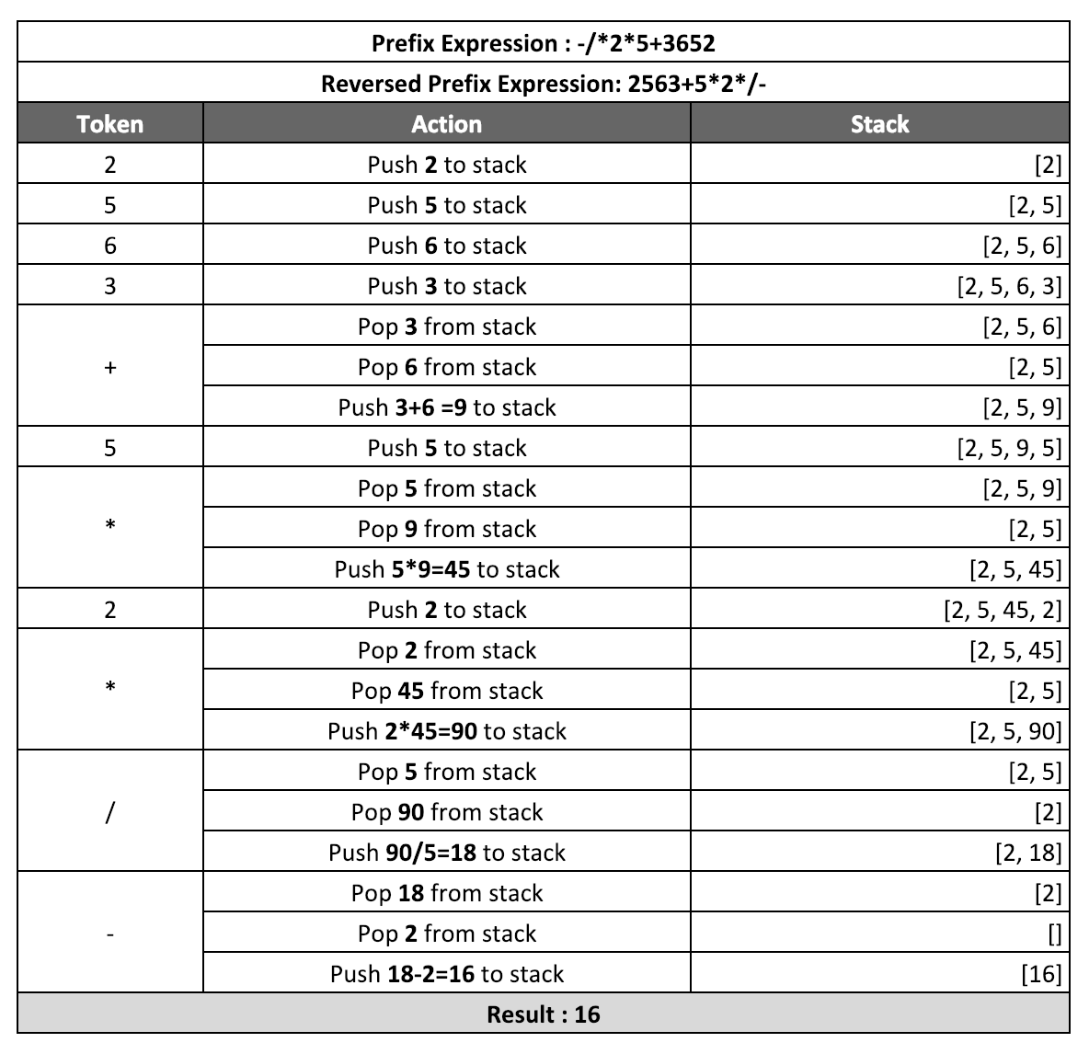
Evaluation of Prefix Expressions (Polish Notation)

Slide 39
def evaluate(a, b, operator):
if operator == '+':
return a + b
elif operator == '-':
return b - a
elif operator == '*':
return a * b
elif operator == '/':
if a == 0:
raise ValueError("Cannot divide by zero")
return b / a
return 0.0
def convert(expression):
stack = []
for c in expression[::-1]:
if c in {'*', '/', '^', '+', '-'}:
s1 = stack.pop()
s2 = stack.pop()
temp = evaluate(s2, s1, c)
stack.append(temp)
else:
stack.append(float(c))
result = stack.pop() output:16.0
return result
if __name__ == "__main__":
exp = "-/*2*5+3652"
print("Prefix Expression:", exp)
print("Evaluation:", convert(exp))

Slide 40
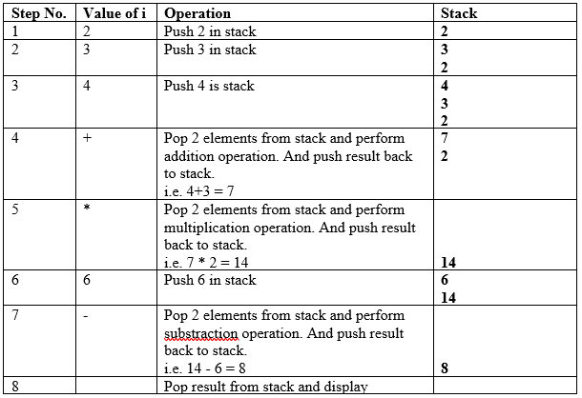
Evaluation of Postfix Expressions

Slide 41
def evaluate_postfix(expression):
stack = []
operators = set(['+', '-', '*', '/'])
for token in expression:
if token not in operators:
stack.append(int(token))
else:
operand2 = stack.pop()
operand1 = stack.pop()
if token == '+':
stack.append(operand1 + operand2)
elif token == '-':
stack.append(operand1 - operand2)
elif token == '*':
stack.append(operand1 * operand2)
elif token == '/':
stack.append(operand1 / operand2)
return stack.pop()
# Example usage:
postfix_expression = ['9', '2', '3', '*', '+', '7', '-', '4', '5', '*', '+', '5', '2', '3', '+', '8', '3', '*', '+', '/', '-']
result = evaluate_postfix(postfix_expression)
print("Evaluation result for postfix expression:", result)
Evaluation result for postfix expression: -26

Slide 42
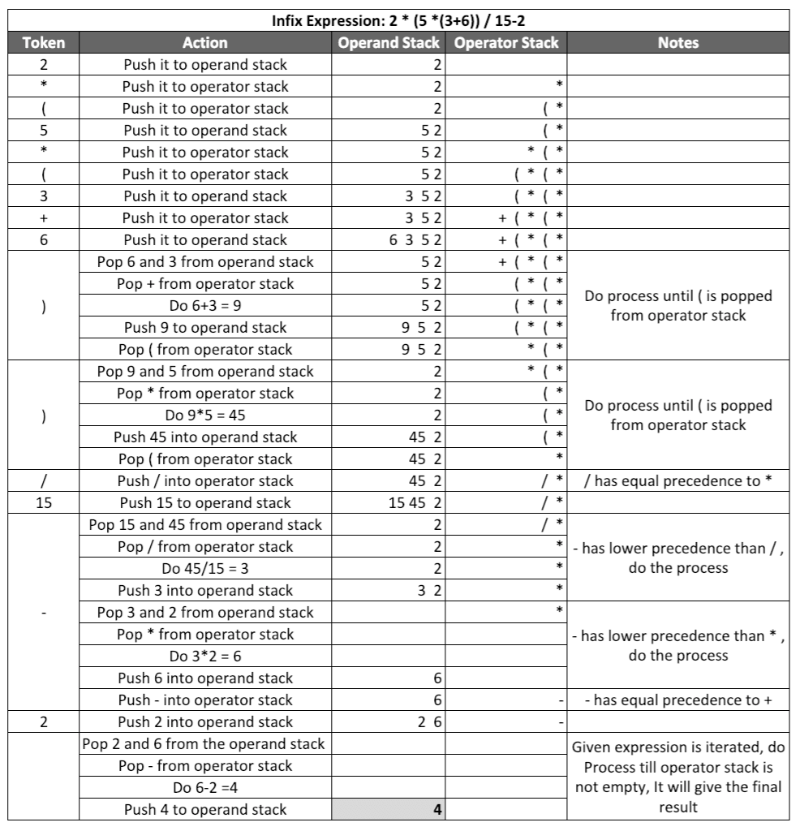
Evaluation of Infix Expressions

Slide 43
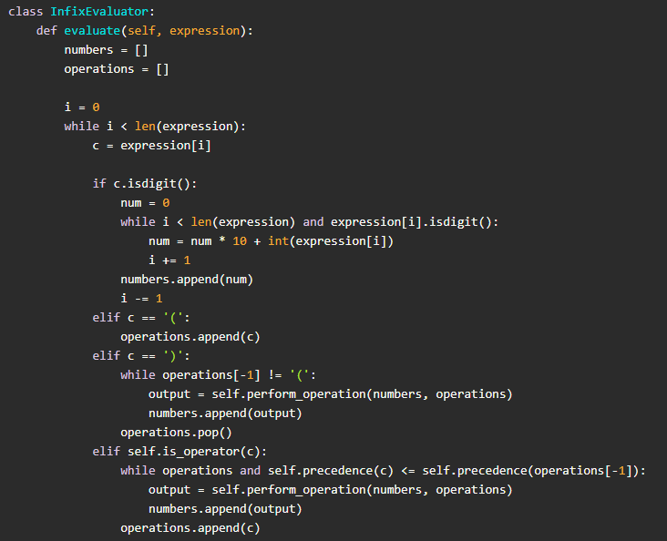

Slide 44
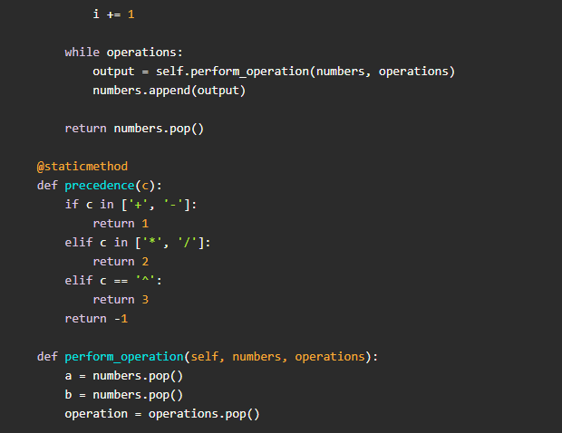

Slide 45
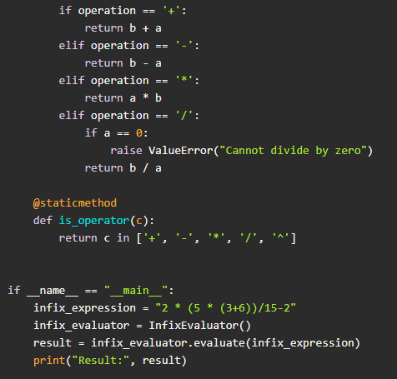

Slide 46
ALGORITHM:
Define the TreeNode class:
Define a class TreeNode representing a node in the expression tree.
Each node has a value, left, and right child.
Define the build_expression_tree function:
Takes a postfix expression as input.
Initializes an empty stack.
Iterates through each token in the postfix expression.
If the token is an operand, create a TreeNode with that value and push it onto the stack.
If the token is an operator, pop the top two elements from the stack (right and left operands).
Create a new TreeNode with the operator as the value and assign the popped operands as its left and right children.
Push this new TreeNode back onto the stack.
Once the iteration is complete, the final element in the stack will be the root of the expression tree.
Return this root.

Slide 47
Define the evaluate function:
Takes a TreeNode as input.
Recursively evaluates the expression tree.
If the value of the node is an operand (isdigit), return its integer value.
Otherwise, recursively evaluate the left and right children.
Perform the corresponding arithmetic operation based on the operator stored in the node.
Return the result.
Define traversal functions:
Define functions for prefix, postfix, and infix traversals.
These functions recursively traverse the expression tree in the respective orders and print the values of the nodes.

Slide 48
Define print_tree functions:
Define functions to print the expression tree in prefix, postfix, and infix notations.
These functions recursively traverse the expression tree and print each node's value.
Example usage:
Define a postfix expression.
Build the expression tree using the build_expression_tree function.
Print the expression tree using the print functions.
Evaluate the expression tree using the evaluate function.

Slide 49
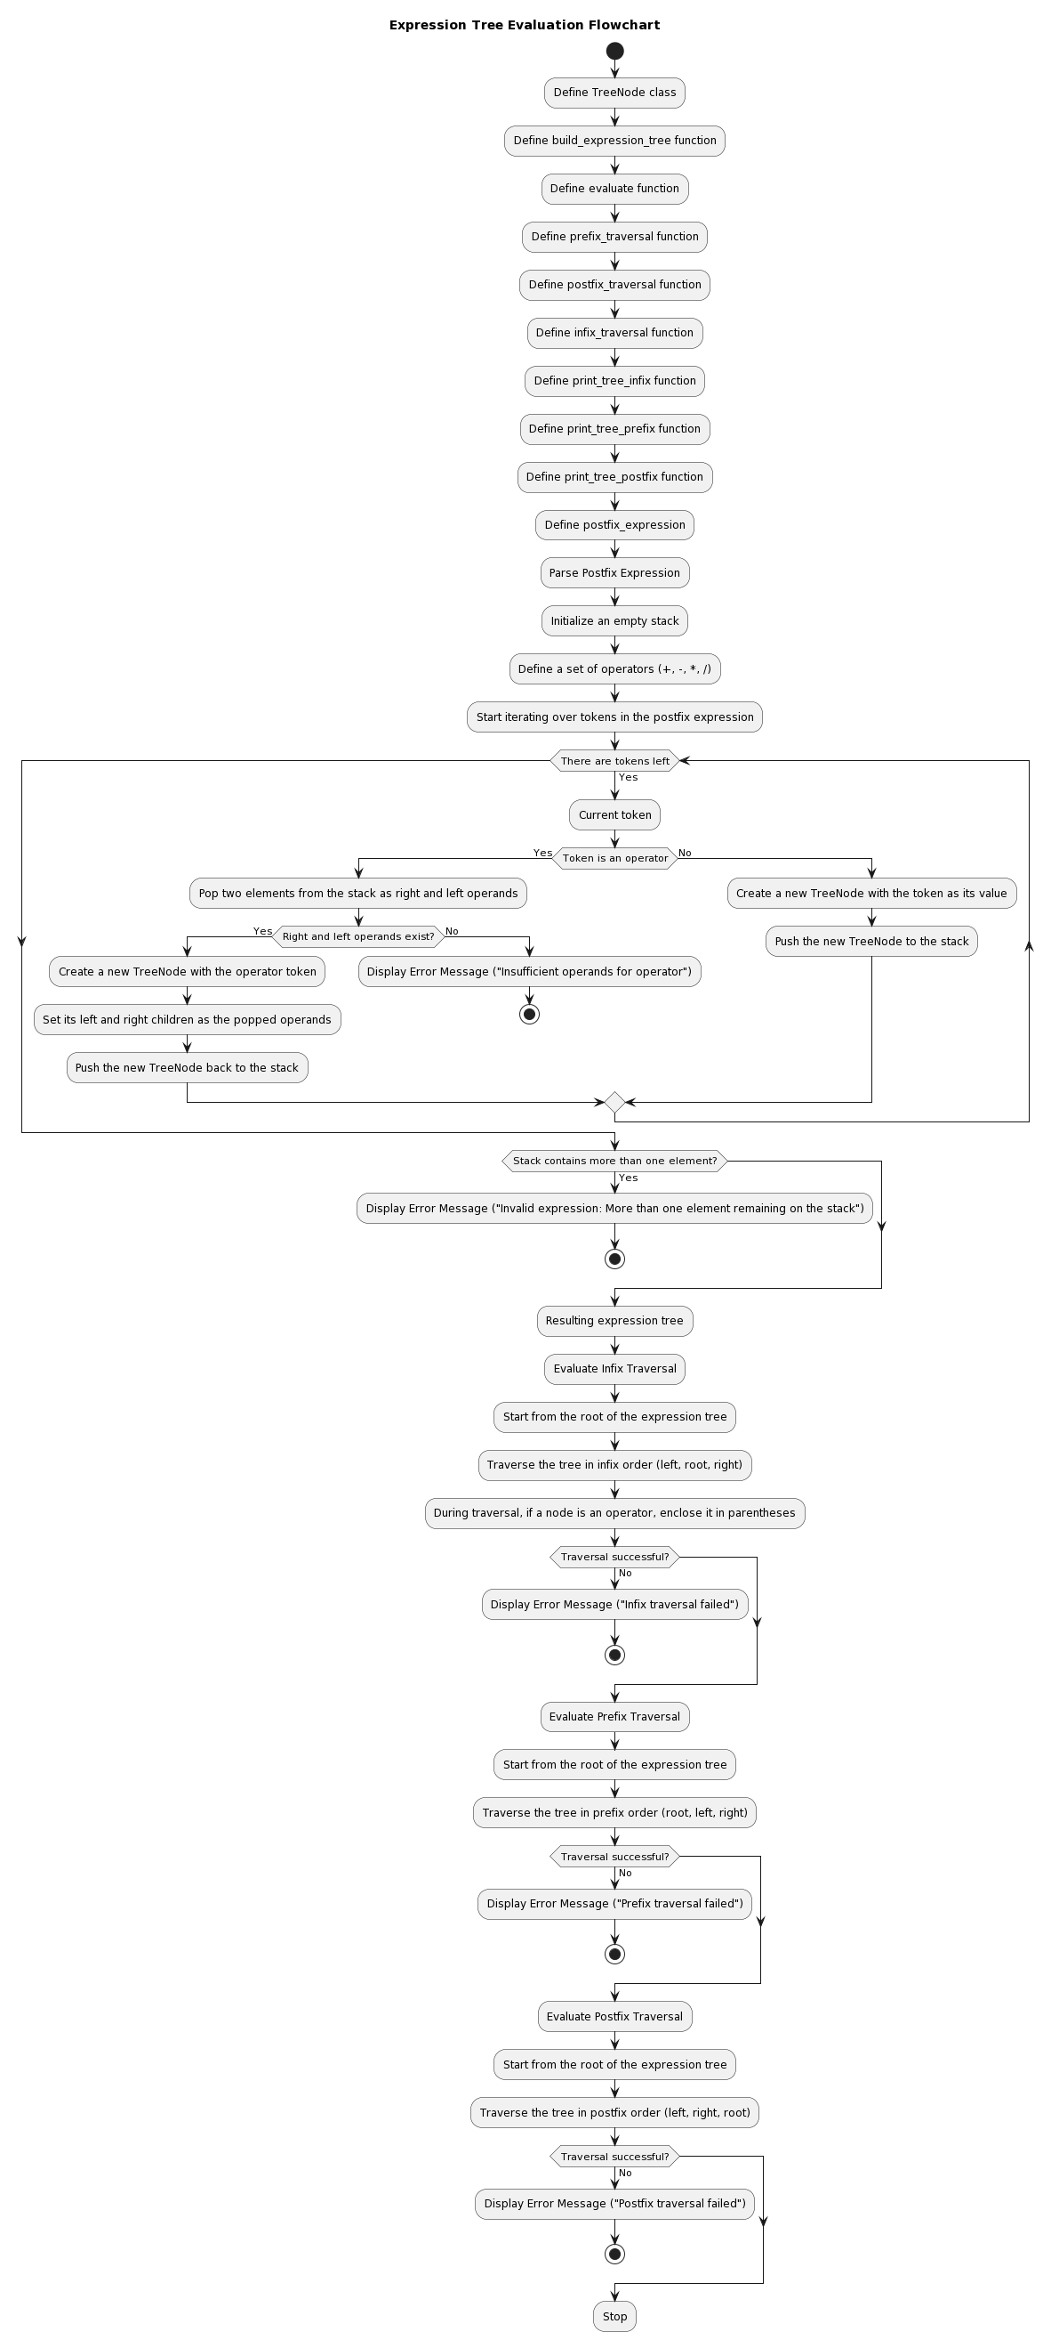

Slide 51
IMPLEMENTATION

Slide 52
class TreeNode:
def __init__(self, value):
self.value = value
self.left = None
self.right = None
def build_expression_tree(postfix):
stack = []
operators = set(['+', '-', '*', '/'])
for token in postfix:
if token in operators:
right = stack.pop()
left = stack.pop()
node = TreeNode(token)
node.left = left
node.right = right
stack.append(node)
else:
stack.append(TreeNode(token))
return stack[0]

Slide 53
def evaluate(node):
if node.value.isdigit():
return int(node.value)
left_val = evaluate(node.left)
right_val = evaluate(node.right)
if node.value == '+':
return left_val + right_val
elif node.value == '-':
return left_val - right_val
elif node.value == '*':
return left_val * right_val
elif node.value == '/':
return left_val / right_val
def prefix_traversal(node):
if node:
print(node.value, end=' ')
prefix_traversal(node.left)
prefix_traversal(node.right)

Slide 54
def postfix_traversal(node):
if node:
postfix_traversal(node.left)
postfix_traversal(node.right)
print(node.value, end=' ')
def infix_traversal(node):
if node:
if node.left or node.right:
print('(', end=' ')
infix_traversal(node.left)
print(node.value, end=' ')
infix_traversal(node.right)
if node.left or node.right:
print(')', end=' ')

Slide 55
def print_tree_infix(node, level=0):
if node is not None:
print_tree_infix(node.left, level + 1)
print(" " * level + str(node.value))
print_tree_infix(node.right, level + 1)
def print_tree_prefix(node, level=0):
if node is not None:
print(" " * level + str(node.value))
print_tree_prefix(node.left, level + 1)
print_tree_prefix(node.right, level + 1)

Slide 56
def print_tree_postfix(node, level=0):
if node is not None:
print_tree_postfix(node.left, level + 1)
print_tree_postfix(node.right, level + 1)
print(" " * level + str(node.value))
# Example usage:
postfix_expression = ['9' ,'2' ,'3', '*','+' , '7' , '-', '4' , '5' ,'*' ,'+' , '5' , '2' , '3', '+' , '8' , '3' , '*' ,'+' , '/' , '-' ]
root = build_expression_tree(postfix_expression)
print("\nInfix traversal:", end=' ')
infix_traversal(root)
print("\nExpression Tree in infix notation:")
print_tree_infix(root)
print("Prefix traversal:", end=' ')
prefix_traversal(root)
print("\nExpression Tree in prefix notation:")
print_tree_prefix(root)
print("\nPostfix traversal:", end=' ')
postfix_traversal(root)
print("\nExpression Tree in postfix notation:")
print_tree_postfix(root)
print("\nEvaluation result For infix:", evaluate(root))
print("\nEvaluation result For prefix:", evaluate(root))
print("\nEvaluation result For postfix:", evaluate(root))

Slide 57
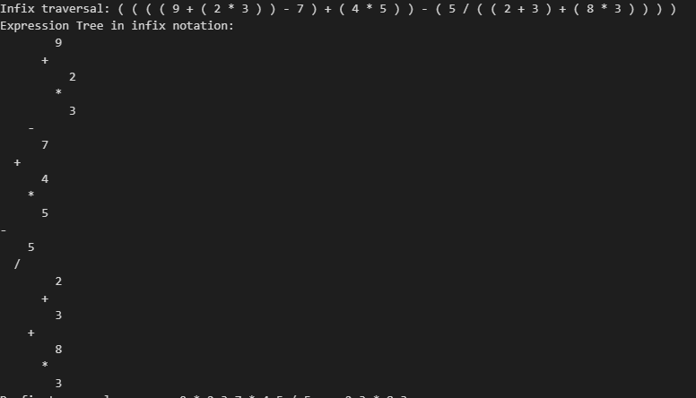

Slide 58
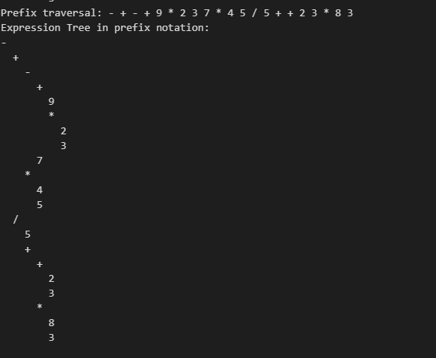

Slide 59
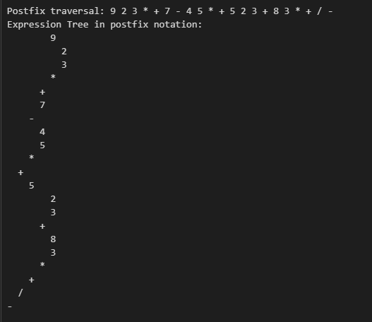

Slide 60
